Slide 1

Who Demands Comparability? Active vs. Passive Institutional Investors
Reginald Edwards
December 4, 2016

Slide 2
Research Question and Findings
What is the differential impact of financial statement comparability on active vs passive investors?
“Active” investors prefer less comparability/passive prefer more
Cross-sectional evidence: OLS estimation in levels and changes
Accounting rule changes as quasi-natural experiments: difference-in-differences analyses
More managerial discretion leads to less comparability, which leads to relatively more active investment

Slide 3
What is “Comparability”?
Conceptually: The inputs to the accounting system that makes
Similar things look alike
Dissimilar economic events and transactions look different
Allows fin stmt users to compare a firm to itself over time and to other firms concurrently
Empirically:
Things get tricky…

Slide 4
Measuring Accounting Comparability
For each firm-year, I extract the “Summary of Significant Accounting Policies” section from annual report
Compare text of industry peers using cosine similarity measure
More similar text yields higher comparability score, COMP
Compute COMP by comparing text of same firm in adjacent years for context

Slide 5
Measuring Accounting Comparability
Cosine similarity
Documents as vectors of word counts
Text reuse/plagiarism detection
Document clustering
See Hoberg, Phillips, and Prabhala (2012) for a finance application
Apple Inc. and its wholly-owned subsidiaries (collectively “Apple” or the “Company”) design, manufacture, and market personal computers, mobile communication devices, and portable digital music and video players and sell a variety of related software, third-party digital content and applications, services, peripherals, and networking solutions.
(Apple 10-K, 2009)
Apple Inc. and its wholly-owned subsidiaries (collectively “Apple” or the “Company”) designs, manufactures, and markets mobile communication and media devices, personal computers, and portable digital music players, and sells a variety of related software, services, peripherals, networking solutions, and third-party digital content and applications.
(Apple 10-K, 2011)
Notes:
Give a short example with text snippets: highlight similar, dissimilar text.

Slide 6
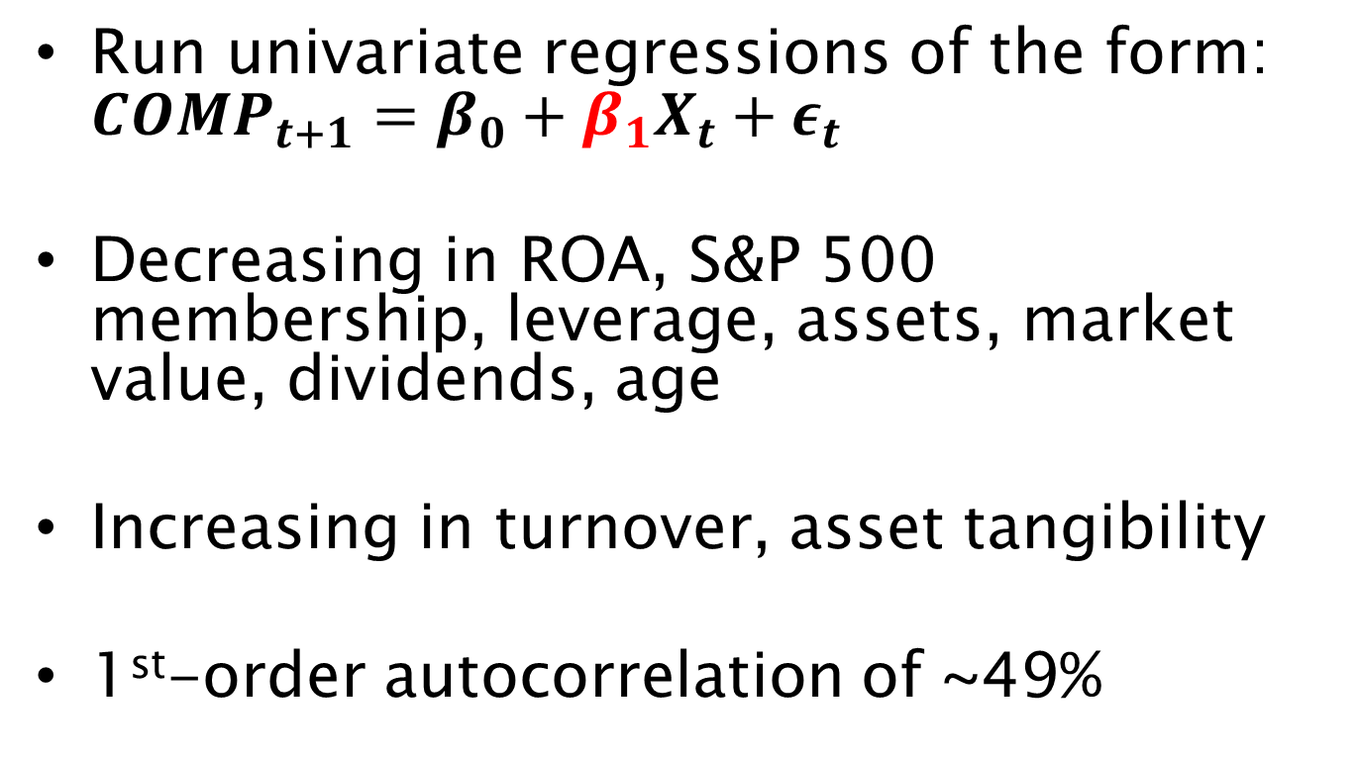
What correlates with comparability?
Run univariate regressions of the form: $COMP_{t+1}=β_{0}+β_{1}X_{t}+ε_{t}$
Decreasing in ROA, S&P 500 membership, leverage, assets, market value, dividends, age
Increasing in turnover, asset tangibility
1st-order autocorrelation of ~49%

Slide 7
Active vs Passive Institutional Investor Ownership
Active institutional investors: investment companies and advisors, pensions, and endowments
Passive institutional investors: banks and insurance companies
Potential misclassification: small, but growing fraction of investment companies include passive funds [see Appel, Gormley, and Keim (JFE, 2016)]
Outcome variables:
PCT-ACTIVE: Proportion of active investor dollars over passive and active investor dollars
NUM-ACTIVE: Proportion of number of active investors over passive and active investors
Notes:
Define active and passive
Establish some empirical regularities
Are index funds in the sample?

Slide 8
Identification Strategy
Threats to causal identification
Reverse causality
Shocks plausibly exogenous to institutional ownership
Correlated omitted variable
DD falsification tests on competing explanations
Extensive control variables

Slide 9
Identification Strategy
Financial Statement Comparability
Active-to-passive institutional investment
Plausibly exog. shocks: SOP 97-2 and ASU 2009-13
COMPARABILITY
PCT-ACTIVE

Slide 10
Managerial Discretion, Comparability, and Ownership
Decreased managerial discretion
More comparable financial statements
Fewer active investors w.r.t. passive investors
Increased managerial discretion
Less comparable financial statements
More active investors w.r.t. passive investors

Slide 11
How does managerial discretion impact financial statements?
Bad: “Managers are opportunistic—they will game the system.”
Holthausen (JAE, 1990)
Watts and Zimmerman (TAR, 1990)
Good: “Managers know most--untie their hands”
Holthausen and Leftwich (JAE, 1983)
Healy and Palepu (Acc. Horizons, 1993)
Predictions for relevance, reliability, and comparability need not be aligned
Notes:
This is clearly an empirical question. And the answer will depend on the outcome under study and the setting.

Slide 12
Two Quasi-Natural Experiments
AICPA SOP 97-2
Intended to stop “aggressive” revenue recognition by software firms
More verifiable and objective determination of selling price allocation
Prohibits managerial estimates of individual elements in multi-element arrangements
FASB ASU 2009-13
Allows more managerial discretion and use of estimates
Lobbied for by some tech giants (but incidental to my outcome measures)

Slide 13
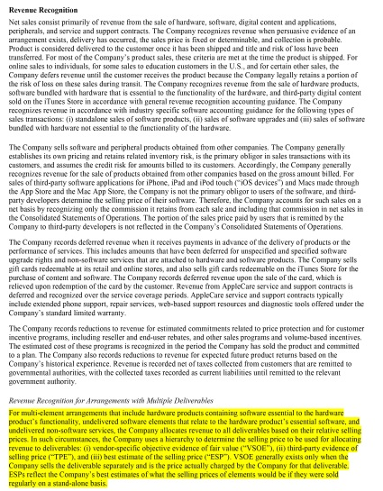
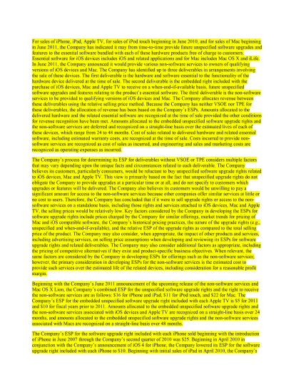
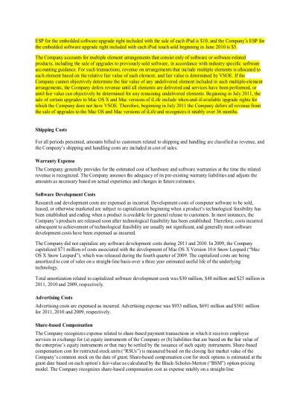
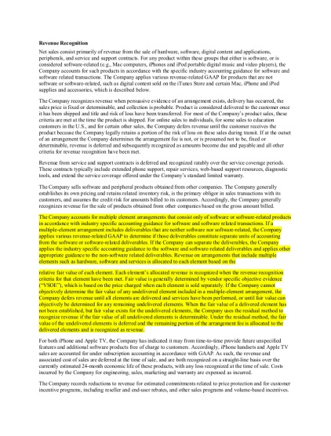
Apple, Inc. Revenue Recognition Disclosure: 2009 vs 2011
Apple, Inc. “Significant Accounting Policies – Revenue Recognition” section of 2011 10-K
Apple, Inc. “Significant Accounting Policies – Revenue Recognition” section of 2009 10-K
Text relevant to new revenue recognition under ASU 2009-13

Slide 14
Do Treatment Events Affect Comparability?
Preliminary Difference-in-differences (DD) estimation of Comparability
Treatment SOP 97-2 event: increase in comparability by around 6.9% after SOP 97-2
Treatment firms for ASU 2009-13 event: a relative decrease in comparability by around 4.97%
Context: average value of comparability in sample is 36.4% and the effect of SOP 97-2 (ASU 2009-13) would be to move the median

Slide 15
DD Estimation Results
Treatment SOP 97-2 event:
exogenous 6.9% increase in accounting comparability causes the share of active institutional investment to decrease by about -4%
Treatment firms for ASU 2009-13 event:
exogenous -4.97% decrease in accounting comparability causes the share of active institutional investment to increase by 1.88%

Slide 16
Contribution
Compared to passive institutional investors, active investors prefer firms with less comparable financial statements
Evidence that more discretion leads to less comparable accounting
A new measure of accounting comparability

Slide 17
Future Work
Companion paper: “A New Measure of Accounting Comparability”
What is the information content of this measure?
Useful in predicting future distress and corporate malfeasance

